Slide 1
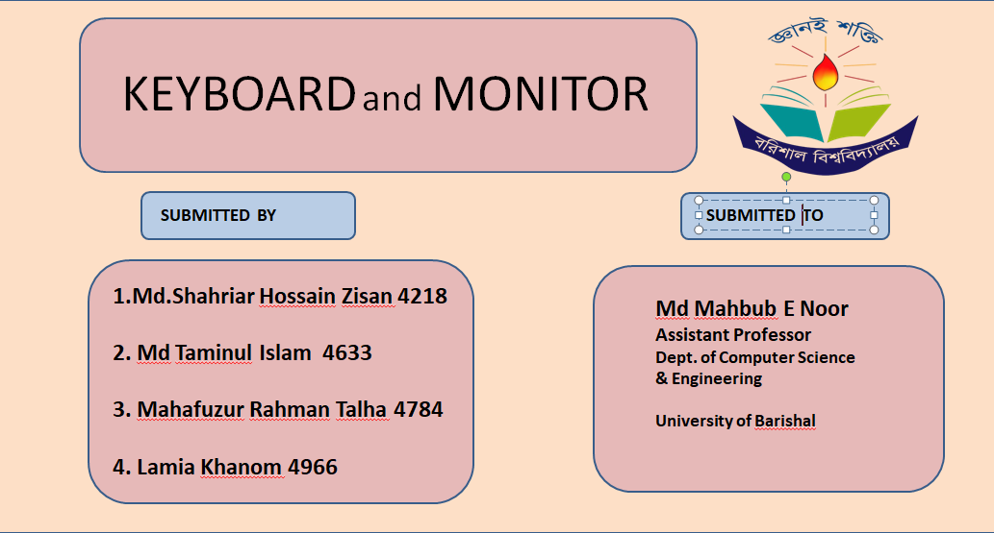

Slide 2
KEY
BOARD
N O R M A L
PRESENTING BY
Md.Shahriar Hossain Zisan
Merit Position:4218
PRESENTING TO
MD Mahbub E Noor
Assistant professor
Dept.of Computer Science and Engineering
University of Barishal
A keyboard is an input device used to type text and commands into a computer or other devices. It consists of keys for letters, numbers, and functions, allowing users to interact with software, control devices, and enter data efficiently.

Slide 3

Invention of Keyboard
The modern keyboard evolved from the 19th-century typewriter, invented by Christopher Latham Sholes in 1868. Sholes' QWERTY layout was designed to prevent mechanical jams, becoming the standard for typewriters and later, computer keyboards. In the 1960s, electronic keyboards began replacing mechanical ones with the advent of computers, and in 1984, IBM's Model M introduced the buckling spring mechanism. Personal computers in the 1980s and 1990s popularized the keyboard, while later innovations led to the development of membrane and wireless keyboards. Today, physical keyboards coexist with virtual and voice-based input methods, continuing to evolve with technology.

Slide 4
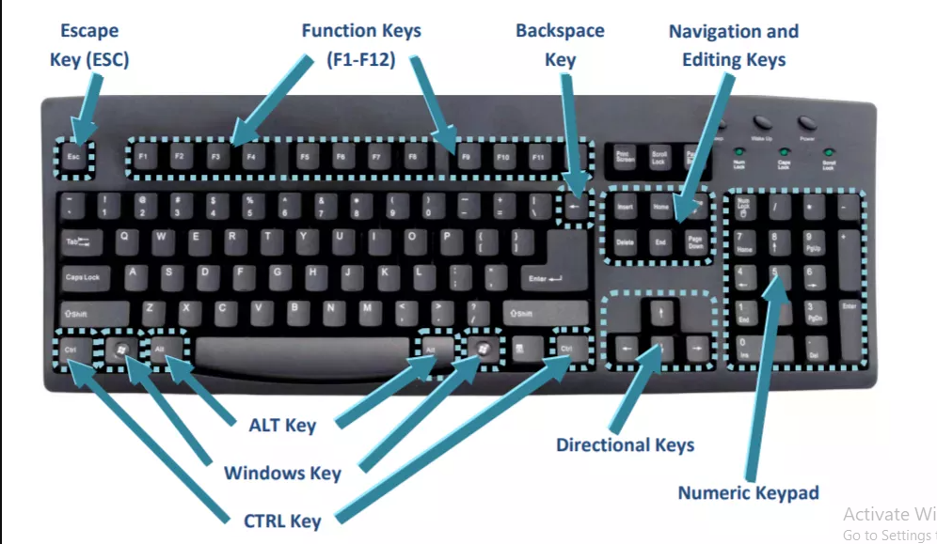
S
Introduction of a Normal Keyboard:
A normal keyboard, typically used with computers and laptops, is an input device consisting of a rectangular layout of keys that includes alphabets, numbers, and function keys. It is primarily used for typing text, entering data, and issuing commands. Standard keyboards feature keys for letters (A-Z), numbers (0-9), punctuation, as well as special keys like Enter, Spacebar, Shift, Ctrl, and Esc. They may also include navigation keys (like the arrow keys), function keys (F1 to F12), and a numeric keypad on the right side for easier number entry. Normal keyboards are often connected to devices via USB or wirelessly and are designed to provide efficient and comfortable typing experiences.

Slide 5
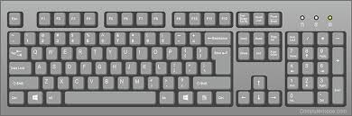
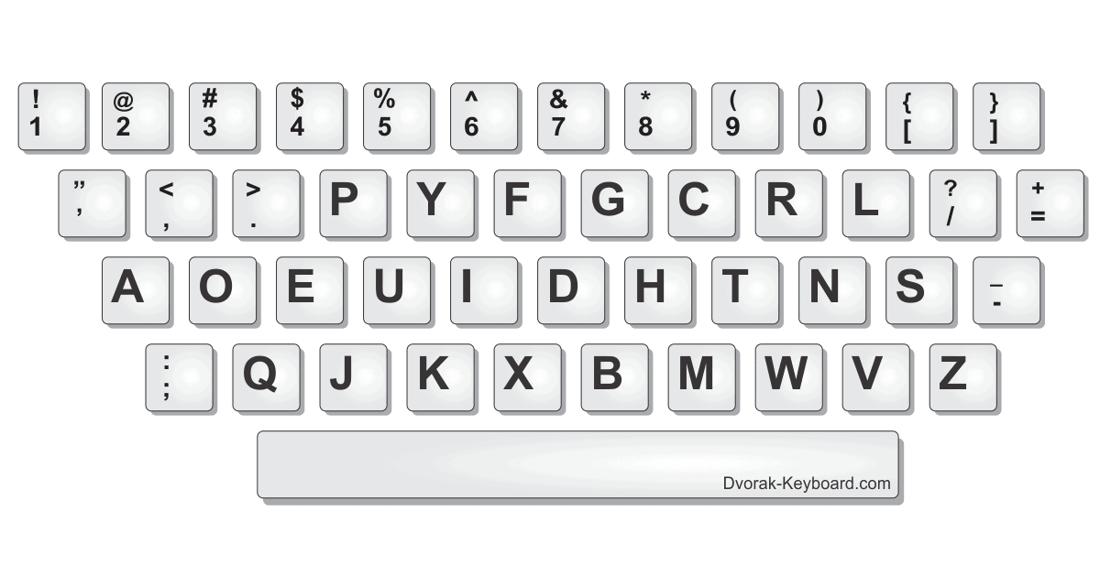
Types of Keyboards
Mechanical Keyboards
• Known for tactile feedback and durability.
Membrane Keyboards
•Quieter and more affordable but less durable.
Ergonomic Keyboards
•Designed to reduce strain on the hands and wrists.
QWERTY Layout
Keyboard Layouts
QWERTY Layout:
The most common keyboard layout used in English-speaking countries.
DVORAK Layout:
Alternative layout designed for faster typing speeds and reduced finger movement.
Other Layouts
AZERTY (used in France)
QWERTZ (used in Germany and Central Europe)
DVORAK Layout

Slide 6
How Keyboards Work
•Mechanical Keyboards: Each key press activates a physical switch that sends a signal to the computer.
•Membrane Keyboards: Keys are pressed onto a soft, rubber membrane that completes an electrical circuit.
•Wireless Keyboards: Connect to devices using Bluetooth or USB receivers, offering greater flexibility and mobility.
Benefits of Keyboards
•Efficiency: Allows fast data entry and control of devices.
•Versatility: Used in a wide range of devices, including computers, tablets, and smartphones.
•Ergonomics: Different designs cater to users' comfort and health needs, reducing strain.

Slide 7
Conclusion
The keyboard remains one of the most crucial and versatile input devices in modern technology.Advancements continue to improve user experience, comfort, and efficiency.Understanding the basics of keyboards is essential for anyone using digital devices today.

Slide 8
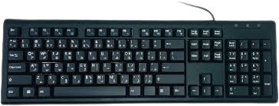

Mechanical and Typewriter Keyboards
Understanding Keyboard Types & Their Unique Features
Submitted By
Md Taminul Islam
Merit: 4633. Dept Of CSE, BU
Submitted To
Md Mahbub-E-Noor
Assistant professor, Dept Of CSE, BU

Slide 9

Overview of Mechanical Keyboard
Which are built for precision & durability
What is Mechanical Keyboard?
A mechanical keyboard uses individual mechanical switches beneath each key, providing a more tactile, durable, and responsive typing experience than any normal keyboard.
Key Features of Mechanical Keyboards:
Different switch types
Ideal for long-term use
Customizable Options
Better Typing Sense & Sound
Gaming Functions
Faster Responses
Anti-ghosting
Highly durable
Why Choose a Mechanical Keyboard?
Mechanical keyboards are preferred for their durability, typing feel, and customization options. They suit a variety of users, including gamers, typists, and programmers who want a reliable, personalized typing experience.

Slide 10

Overview of Typewriter Keyboard
The beginnings of typing: The first-ever keyboards designed for writing
What is a Typewriter Keyboard?
A typewriter keyboard is a layout of keys designed for typing letters, numbers, and symbols on a typewriter, an early mechanical device used to print text on paper.
Key Features of Typewriter Keyboards:
No Need for Electricity
Unique Typing Sound
Ink Ribbon System
Click-clack Sound
Manual Tab Key
Fixed Line Spacing Options
Shift Key for Capitals
Mechanical Keys
Why Choose a Typewriter Keyboard?
A typewriter keyboard is ideal for those who enjoy the simplicity of analogue tools. Its distinct design encourages focused, distraction-free writing without digital interruptions. Plus, it doesn’t require electricity, making it reliable and portable. For writers and collectors, it’s also a unique and charming alternative to modern keyboards.

Slide 11

No Need for Electricity
Ink Ribbon System
Click-clack Sound
No Gaming Functions
Fixed Line Spacing Options
Durable & Reliable
Unique & Analogue
Need for Electricity
No Ink Ribbon System
Virtual Sound
Best for Gaming
Customizable Options
Highly durable
Modern keyboard

Slide 12
Thank you for watching my presentation

Slide 13

NEW MONITORS AND OLD MONITORS....
SUBMITTED BY
SUBMITTED TO
Mahafuzur Rahman Talha(4784)n Talha
Prof. Md Mahbub E Noor
University of Barisal – 13th batch
Assistant Professor
Department of CSE – 11th batch
Dept. of Computer science and Engineering
Merit Position - 4784
University of Barisal
Merit Position - 4784

Slide 14

CONTENTS-
What is a monitor?
Evolution of monitors.
More about old monitors(CRT monitors).
Difference between old monitors and new monitors.

Slide 15

What is a monitor?
A monitor is an output device that displays images, videos and other types of information to the user.
Monitors can vary from each other in sizes, resolutions and refresh rates.
So, its quality is often measured by screen size, resolution and refresh rate.

Slide 16
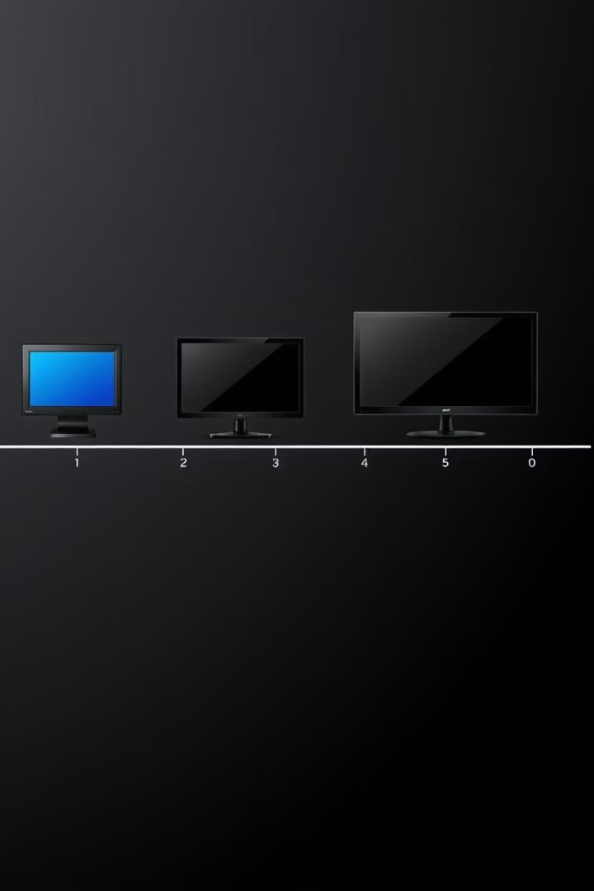
EVOLUTION OF MONITORS
CRT Monitors
CRT (cathode ray tube) monitors, which uses an electron beam to create images on a phosphor-coated screen. It was invented in 1897, making it one of oldest types of monitors.
LCD Monitors
LCD is short for Liquid Crystal Display. It was invented in 1968. And it is still quit popular as it is still being used in various sectors.
OLED Monitors
OLED stands for Organic Light Emitting Diode. Which is the latest technology. And it has faster response time

Slide 17

CRT monitors...
DEFINATION
CRT, Cathode Ray Tube monitors use electron beams and phosphorescent screens to create images. They were popular as It was being used in computers and other devices through 1950s to 2000s.
HOW IT WORKS...
Electrons are shot onto an phosphor-coated screen. And it uses an analog display which displays the image as continuous signals.

Slide 18
CRT monitors...
ADVANTAGES
DISADVANTAGES
It has better color accuracy compared to early LCDs
Large compared to modern flat-screen displays
It's refresh rates provided smooth motion for gaming.
Higher power usage than newer technologies.
It had larger screen size. typically larger than early LCDs.
LCD, LED, and OLED monitors eventually replaced CRTs due to better efficiency.

Slide 19
Difference between old and new monitors
FEATURE
OLD MONITOR
NEW MONITOR
Size
Large and bulky
Thin and lightweight
Resolution
Lower
Higher
Refresh Rate
Lower
Higher
Response Time
Slower
Faster
Power Consumption
Higher
Lower
CONCLUSION : AFTER LEARNING THE DIFFERENCE BETWEEN OLD AND NEW MONITORS WE CAN SAY THAT THE PERFORMANCE OF NEW MONITOR IS WAY BETTER THAN THAT OF NEW MONITORS..

Slide 20
MONITOR
LED LCD OLED QLED WLED
SUBMITTED TO
SUMITTED BY
Md Mahbub E Noor
Assistant Professor
Dept. of Computer Science & Engineering
University of Barishal
Lamia Khanom
Merit Position: 4966

Slide 21
INTRODUCTION
Modern monitors come in a variety of display technologies, each with distinct features and advantages. Understanding the differences between LED, LCD, OLED, QLED, and WLED monitors is essential when choosing the right display for your needs. In this presentation, we will explore each of these technologies, their pros and cons, and how they impact the performance and visual quality of monitors.
LED (Light Emitting Diode)
Overview:
LED monitors are actually a type of LCD display. The term LED refers to the backlighting technology used in these monitors. Unlike traditional CCFL backlighting, LED backlights use LEDs to illuminate the liquid crystals.
Key Features:
LED Backlighting: Uses LEDs to provide the light source behind the LCD panel.
Edge-lit vs Full-array: LED monitors can either be edge-lit (LEDs around the edges) or full-array (LEDs across the entire panel).

Slide 22
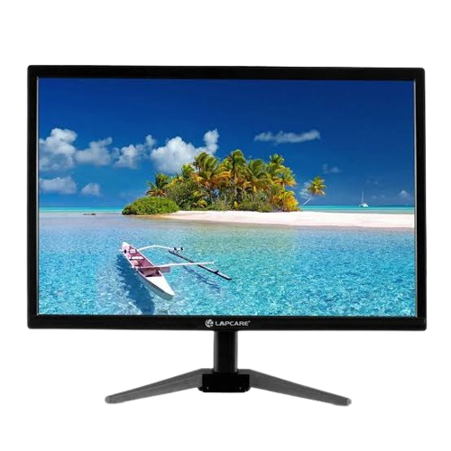
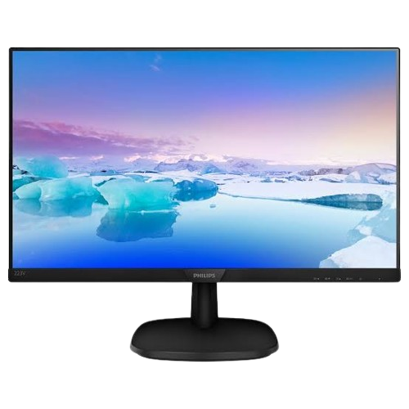
Pros:
•Thinner and more energy-efficient than CCFL-backlit LCDs.
•Can achieve better brightness and contrast ratios than traditional LCDs.
•Available in both edge-lit and full-array configurations.
Cons:
•Still relies on liquid crystals, so black levels may not be as deep as OLED.
•Edge-lit models may have uneven lighting.
LCD (Liquid Crystal Display)
LED Monitor
Key Features:
•Backlight: Typically uses cold cathode fluorescent lamps (CCFL) or LED as backlight.
•Resolution & Colors: Offers good color accuracy but can struggle with deep blacks and contrast ratios.
•Energy Efficient: More energy-efficient than CRTs, but less efficient than newer technologies like OLED.
Overview:
•LCD is a type of display technology that uses liquid crystals to create an image. These liquid crystals don't emit light by themselves but instead modulate light from a backlight.
LCD Monitor

Slide 23
Cons:
•Limited contrast ratios.
•Less vibrant colors compared to OLED.
•Poor black levels (blacks appear gray due to backlight bleed).
Pros:
•Inexpensive to manufacture.
•Wide range of sizes and resolutions.
•Low power consumption compared to older CRT monitors.
OLED (Organic Light Emitting Diode)
Overview:
OLED is a display technology where each individual pixel emits its own light, unlike LCDs, which require a backlight. This allows for true blacks and exceptional contrast.
Key Features:
•Self-Emitting Pixels: Each pixel can turn on or off independently, offering true black levels and infinite contrast.
•Vibrant Colors: OLED displays can reproduce a wide color gamut and more vibrant colors compared to traditional LED/LCD displays.

Slide 24
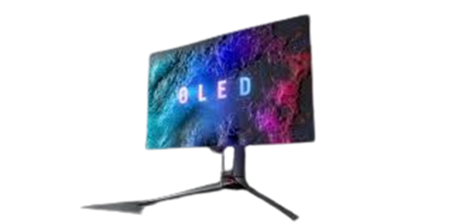
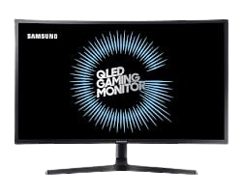
Pros:
•Excellent contrast ratios and true blacks.
•Faster response times, making them ideal for gaming.
•Wider viewing angles without color distortion.
Cons:
•Can be more expensive than LED/LCD monitors.
•Prone to burn-in (permanent image retention) if static images are displayed for long periods.
•Shorter lifespan compared to LED displays, especially in blue OLEDs.
OLED Monitor
QLED (Quantum Dot LED)
Overview:
QLED is a term coined by Samsung, referring to Quantum Dot LED technology. It's a variation of LED/LCD technology that uses a layer of quantum dots between the LED backlight and the LCD panel.
Key Features:
•Quantum Dots: These nanometer-sized particles improve brightness, color accuracy, and overall image quality.Full •Array Local Dimming (FALD): Many QLED displays feature this technology, allowing for enhanced contrast by dimming or brightening specific areas of the screen.
QLED Monitor

Slide 25
Pros:
•Offers a wider color gamut and better color accuracy than standard LED displays.
•Can reach higher brightness levels than OLED, making them better suited for bright rooms.
•Improved contrast ratios and deeper blacks with local dimming.
Cons:
•Still uses a backlight, so blacks aren’t as deep as OLED.
•Expensive compared to standard LED displays.
WLED (White LED)
Key Features:
Backlighting Technology: WLED uses a white LED light source to illuminate the liquid crystal panel.No Color Filter: Some WLED displays use a phosphor coating on the LEDs to improve color quality.
Overview:
WLED stands for White LED. This is a type of LED backlighting used in LCD displays where the backlight is provided by white LEDs.

Slide 26
Pros:
•More energy-efficient than traditional CCFL backlights.
•Can achieve bright and uniform screen lighting.
Cons:•Not as color-accurate or vibrant as QLED or OLED.
•Limited contrast compared to OLED or QLED.
Each display technology — LCD, LED, OLED, QLED, and WLED — has its own strengths and weaknesses. Your choice depends on factors such as budget, intended use, and personal preferences for color accuracy, brightness, and contrast. Whether you're a gamer, a content creator, or simply looking for a quality monitor for daily use, understanding these technologies will help you make an informed decision.
CONCLUSION
Choosing the Right Monitor for Your Needs
For Budget-Conscious Users: LCD or WLED monitors are affordable and offer decent performance for basic tasks like office work or web browsing.For Gaming or Multimedia Enthusiasts: OLED offers unbeatable contrast, fast response times, and superior color accuracy, making it a top choice for gamers and those who enjoy high-quality video content. Be mindful of burn-in risk.For Bright Rooms and Color Accuracy:QLED excels in bright environments and can deliver better overall brightness and color volume than OLED. It’s perfect for vibrant media consumption or HDR content.For Standard Use and Energy Efficiency:LED or WLED displays are still a solid choice for most everyday tasks, offering good energy efficiency and visual quality at a reasonable price.

Slide 27
University of Barishal 13th Batch
Presentation title: Projctor type monitor
SUBMITTED BY
Name:Rafia Aktar
Department of CSE-11th Batch
SUBMITTED TO
Prof.Md Mahbub E Noor
Course code-CSE1101
Course title-Introduction to computer system

Slide 28

PROJECTOR TYPE MONITOR
A projector-type monitor typically
refers to a display system that
uses a projector to create an
image on a surface (like a wall or
screen), rather than using a
traditional flat-panel monitor .
In some contexts, projector type monitor also refer to devices that project interactive displays ,like interactive projectors or short-throw projectors that can be used for presentations , education or even home entertainment.

Slide 29
There are several types of projectors,including
LCD projectors:
These projectors are often used as a replacement for slide or overhead projectors. However ,they typically require filter maintenance and produce less contrast.
LED projectors:
These projectors are use light emitting diodes to display an image on the screen.they are often bright,high-fidelity and smaller in size.
DLP projectors:
These projectors use tiny mirrors to reflect light. They are the most commonly used projector technology for all types of applications.
Laser projectors:
These projectors use laser diodes as their light source and offer superior image quality,high contrast and exceptional color accuracy. They also have an impressive lifespan,often exceeding 20,000 hours.

Slide 30

How does a projector works?
When you connect a projector to a
video source ,such as a computer
or a media player ,it receives the
video signal and processes it . The
projector then uses lamp or light
emitting diode(LED) light source to produce a bright beam of light. This light passes through a series of mirrors and lenses that help magnify and focus the image. The focused light is then projected onto a screen or wall, creating a larger image for the audience to see.

Slide 31
Advantage of projector over monitor
Screen size: Projectors can display much larger images than monitors.
Eye comfort : Projectors use indirect lighting which reduces eye strain.
Portability :Projectors are lightweight and easy to move around.
Cost: Projectors are often cheaper than TVs of similar size.
Disadvantage of projector over monitor
Brightness: Projectors are generally less bright than TVs, so ambient light can affect the image quality , especially during the day.
Image quality: When projecting a large image can be darker.
Room requirements: Projectors need a dark room to deliver their best image quality.
Eye safety: Looking directly at the projector lens while it’s on can damage your eyes.

Slide 32
Thank you

